Slide 1
The Present Continuous
(Progressive) Tense
Презентация 5 класс
Выполнена учителем английского языка Левшаковой О.Н.

Slide 2
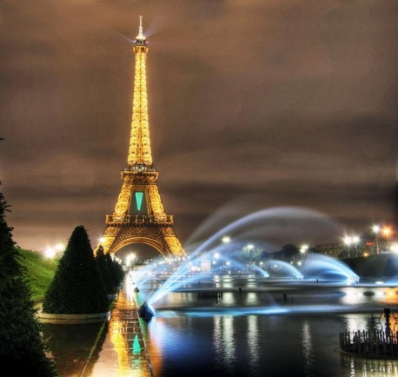
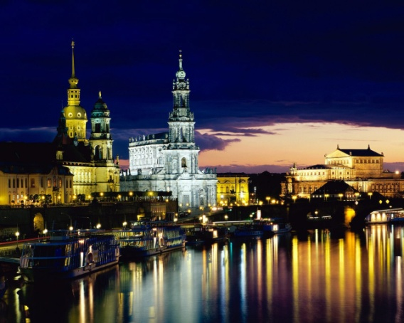
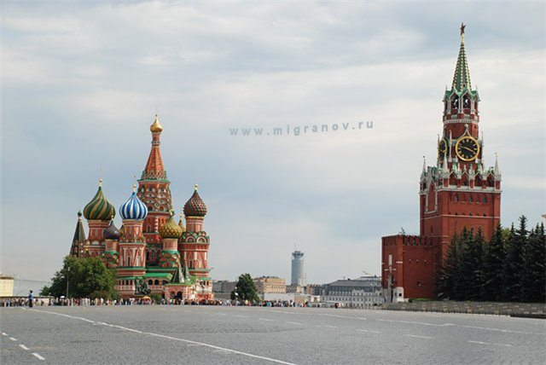
What tenses do we use?
What do the underlined words mean?
тогда
I like to travel……
Last year I was in France. (Past Simple)
This year I am in Russia. (Present Simple)
Next year I will be in Germany. (Future Simple)
потом
сейчас

Slide 3
Let’s remember…Present Simple
Если ты говоришь о том, что происходит обычно, то надо употреблять глагол в Present Simple.
I, You, We, They - V
He, She, It - V+s
I
verb - глагол
every year
every weekend
usually
on Sundays
every day

Slide 4
НО!! Если ты хочешь сказать о том, что происходит в момент речи, то глагол надо употреблять в ……Present Continuous
AM
IS + V+ ING
ARE
V –I ФОРМА ГЛАГОЛА
now
HE / SHE/ IT IS
at the moment
I AM
to BE
YOU / WE/ THEY ARE

Slide 5
Statements, questions and negations
(утверждения) (вопросы) (отрицания)
I am reading. - Am I reading? – I am not reading.
(Yes, I am./No, I’m not.)
He He He
She is reading. – Is She reading? – She is not reading.
It It It
(Yes, she is./No, she isn’t.)
You You You
We are reading. – Are We reading? – We are not reading.
They They They
(Yes, we are./No, we aren’t.)

Slide 6


НО!! Есть глаголы, которые никогда не употребляют в Continuous.
like (нравится)
want (хотеть)
know (знать)
prefer (предпочитать)
need (нуждаться)
love (любить)
remember (помнить)
understand (понимать)
hate (ненавидеть)
forget (забывать)
believe (верить)
depend (зависеть)

Slide 7
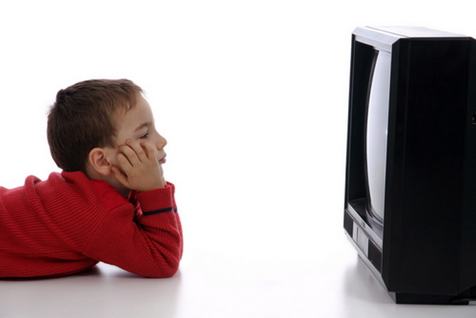
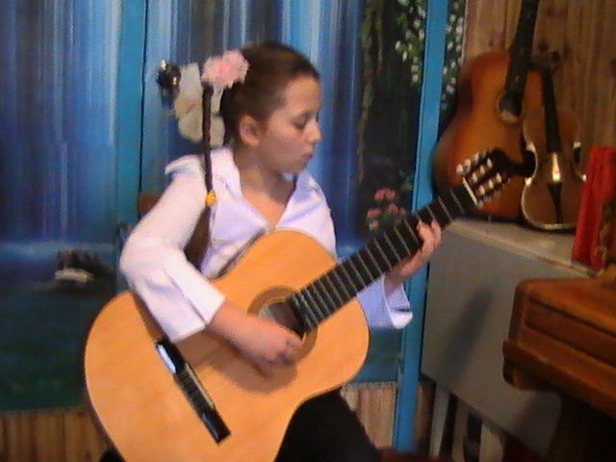
Present Simple and
Present Continuous
He usually reads books, but now he is watching TV.
She plays violin well, but she is playing guitar at the moment.

Slide 8

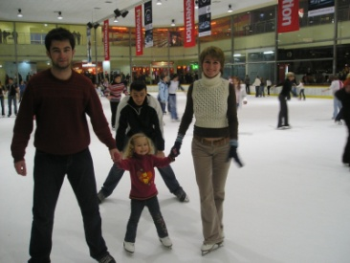
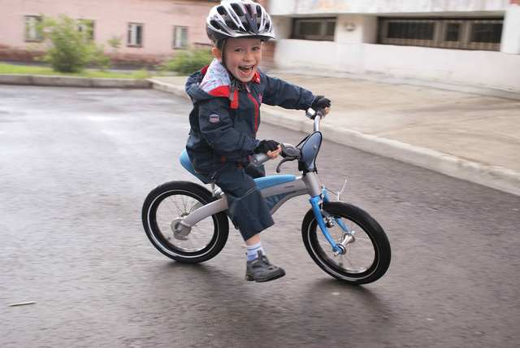
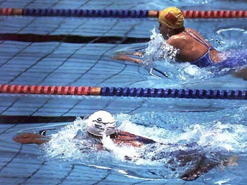
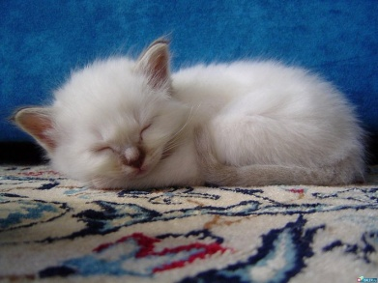
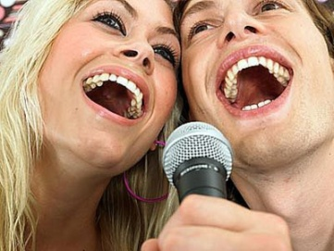
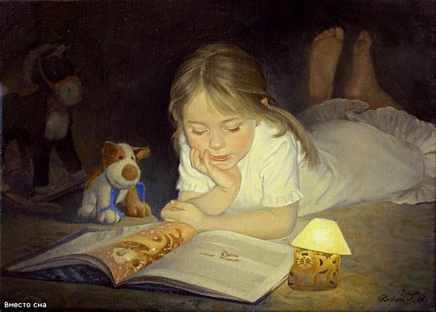
Look at the pictures. What are they doing?
The girl is They are
They are He is
We are It is
She is

Slide 9
Write the ing-form.
Example: sing – singing, write – writing, put-putting.
go –
work –
watch -
make –
shake –
smile –
run –
travel-
knit –
speak -
play -
ing

Slide 10
Let’s check!
go – going
work – working
watch - watching
make – making
shake – shaking
smile – smiling
run – running
travel- travelling
knit – knitting
speak - speaking
play - playing

Slide 11
Open the brackets:
He (to go) to school now. – is going
She(to help) her mother now. – is helping
They (to go) to the cinema now. - are going
It (to sleep) now. – is sleeping
They (to drink) coffee now. – are drinking
You (to playing ball) now? – Are ….playing ….?
I (not to sing) now. – am not singing
What you (to do) now? – What are ….doing….?
Where they (to live) now? – Where are ….living…?
She (not to walk) in the park now. – is not walking

Slide 12
Make the sentences:
Is, He, guitar, playing, at the moment.
They, now, playing, are, hide-and-seek.
We, are, watching TV, not.
Are, walking, in the park, you?
Crying, is the girl.
Are, drawing, the children, now, funny pictures.
The boys, hands, are, shaking.
Riding, he, is, his bike, at the moment?
Your mum, an interesting book, now, reading, is? – Yes, she is.

Slide 13
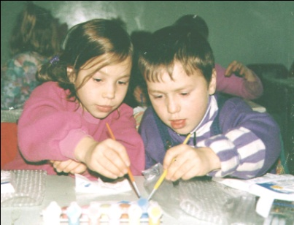
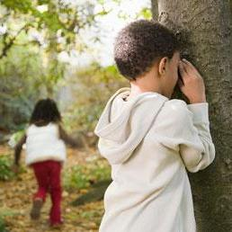
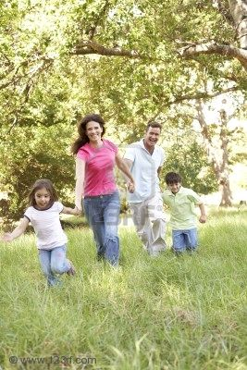
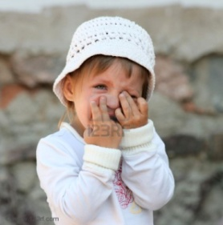
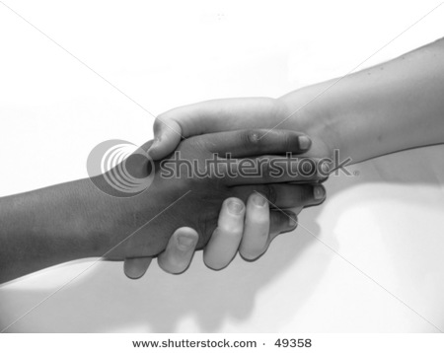
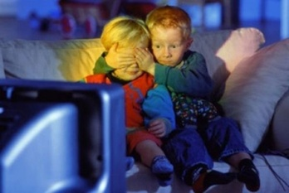

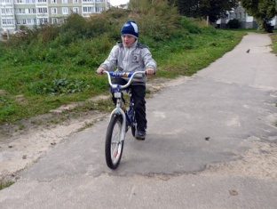
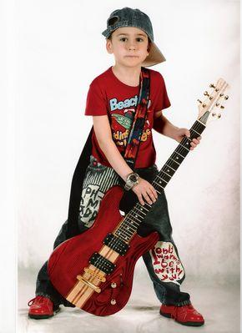
Let’s check!
He is playing guitar at the moment.
They are playing hide-and-seek now.
We are not watching TV.
Are you walking in the park?
The girl is crying.
The children are drawing funny pictures now.
The boys are shaking hands.
Is he riding his bike at the moment?
Is your mum reading an interesting book now? – Yes, she is.

Slide 14

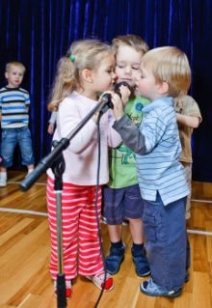
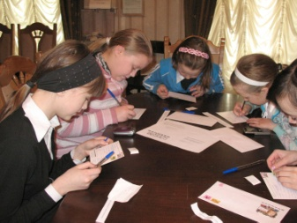
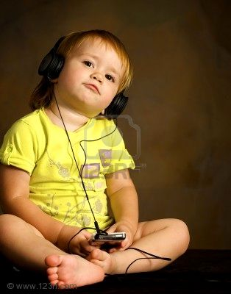
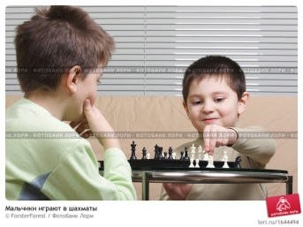
Read, look at these pictures and give a short answer.
Is the boy dancing?
Are they singing?
Are the pupils reading?
Is Ann listening to music?
Are the friends playing computer games?

Slide 15
Put questions and make negative sentences:
1. The children are reading fairy tales.
The children (not to read) fairy tales.
Who…..?
What…?
2. We go to the cinema now.
We (not to go) to the cinema.
Where……to?
When……….?
3. She is dancing well now.
She (not to dance) well now.
How…..?
What …?

Slide 16
Present: Simple or Continuous?
1. I (to read) now. I (to read) every day.
2. He (to sleep) now. He (to sleep) every day.
3. We (to drink) tea now. We (to drink) tea every morning.
4. I (not to sleep) now. I (not to sleep) in the daytime.
5. We (not to watch) TV now. We (not to watch) TV in the morning.
6. What you (to do) now? What you (to do) every morning?
7. What they (to eat) now? What they (to eat) for breakfast?
8. My mother (not to work) now. My mother (not to work) at an office.
9. He (to play) now? He (to play) in the afternoon?
10. What she (to read) now? What she (to read) after dinner?

Slide 17
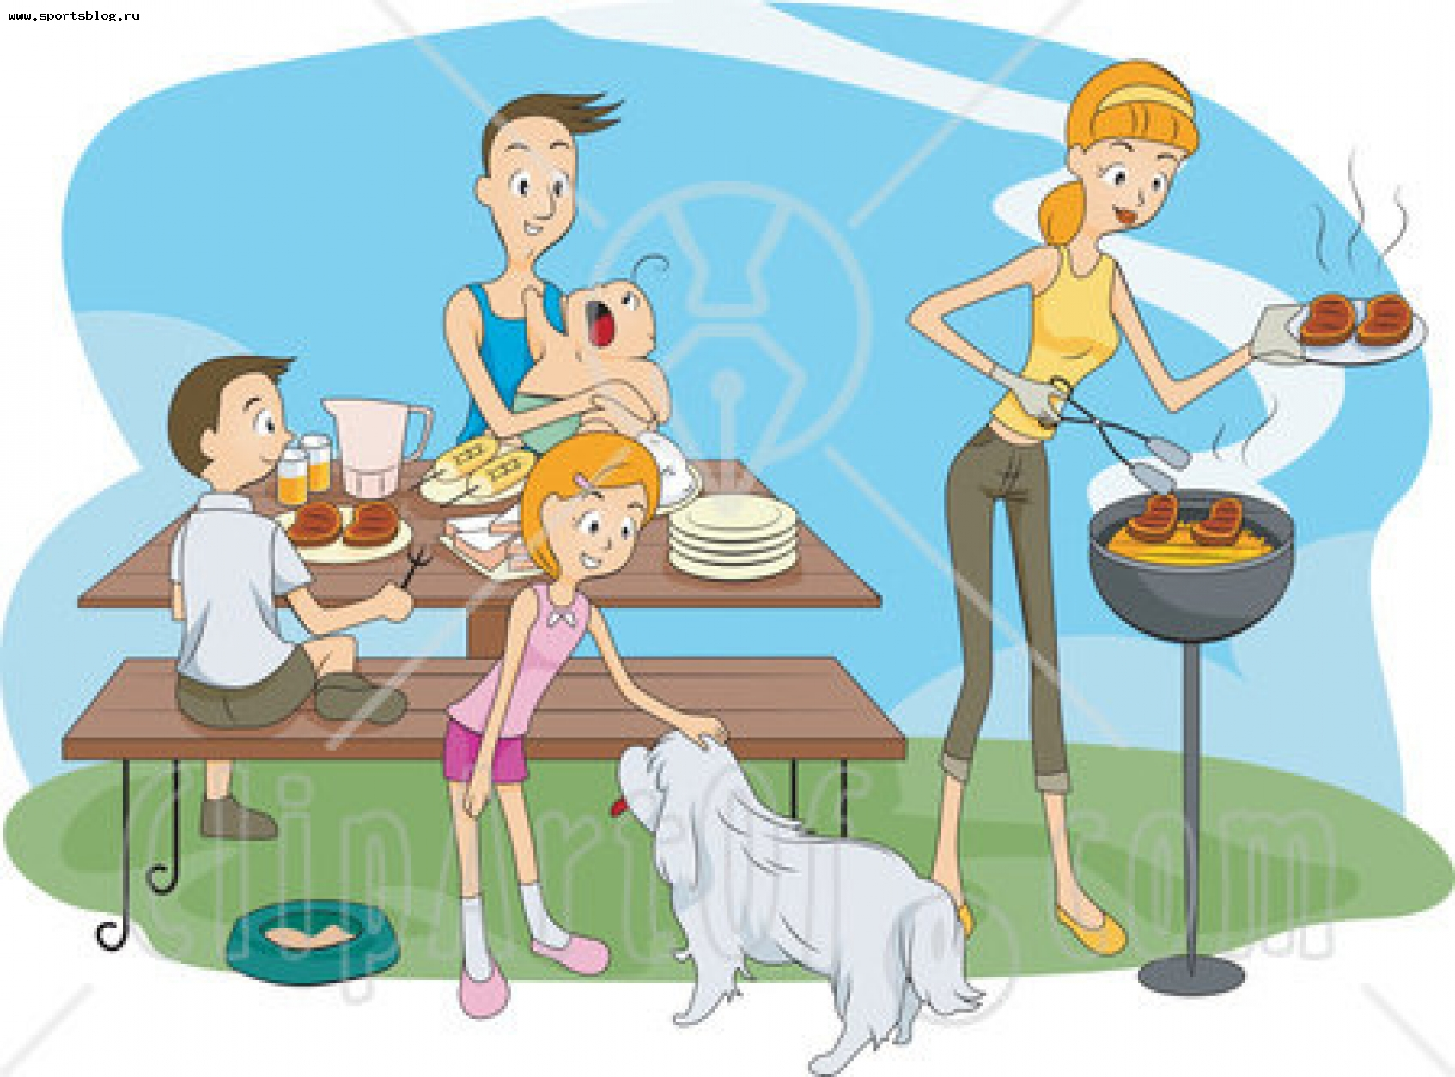
Let’s describe these pictures.

Slide 18
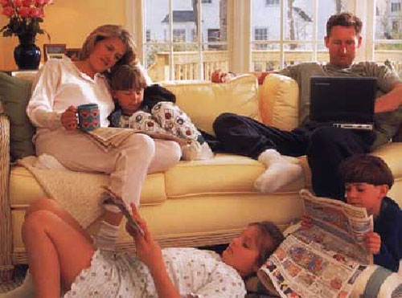

Slide 19
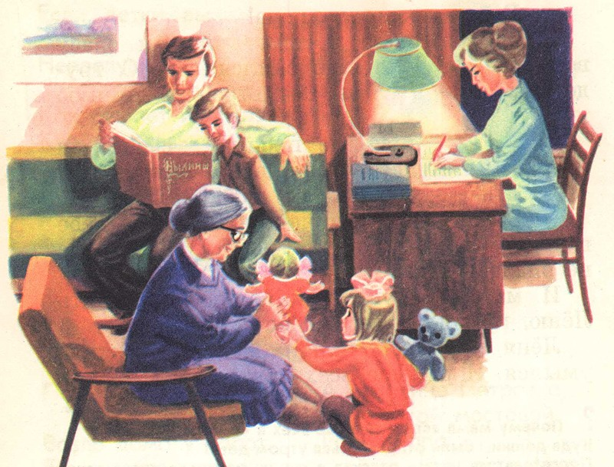

Slide 20



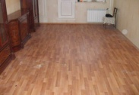

Let’s finish our lesson with this poem:
I am counting to ,
You are giving them a ,
She is looking at the ,
He is sitting on the floor.
All of us are working well,
Waiting, waiting for the

Slide 21
Thanks a lot!!

